Slide 1
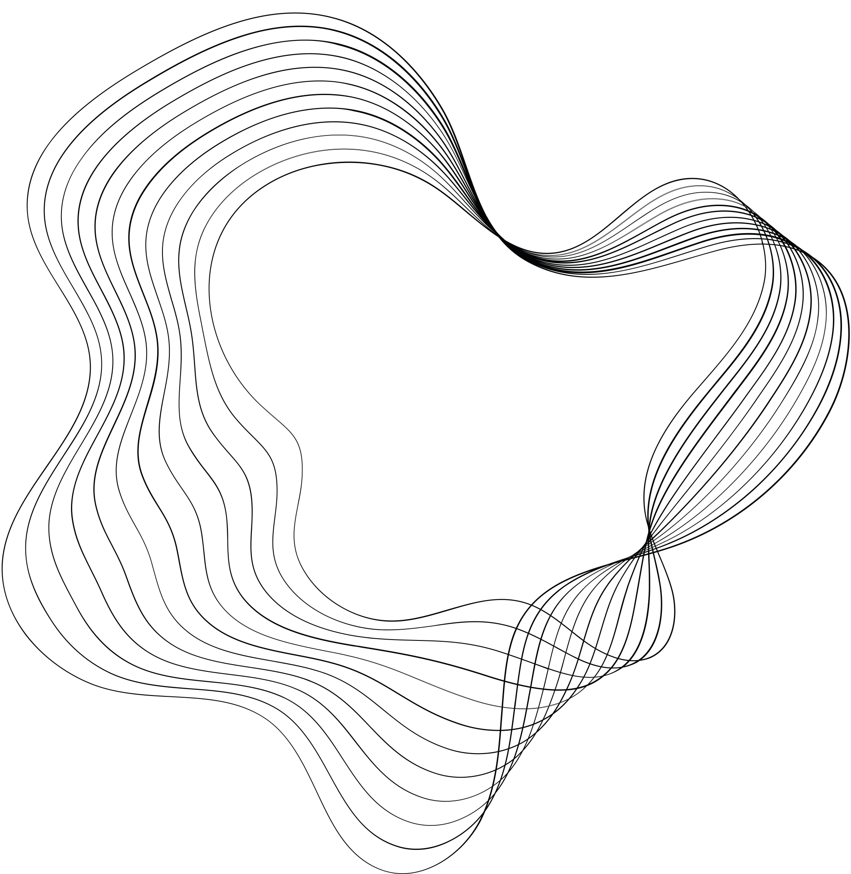
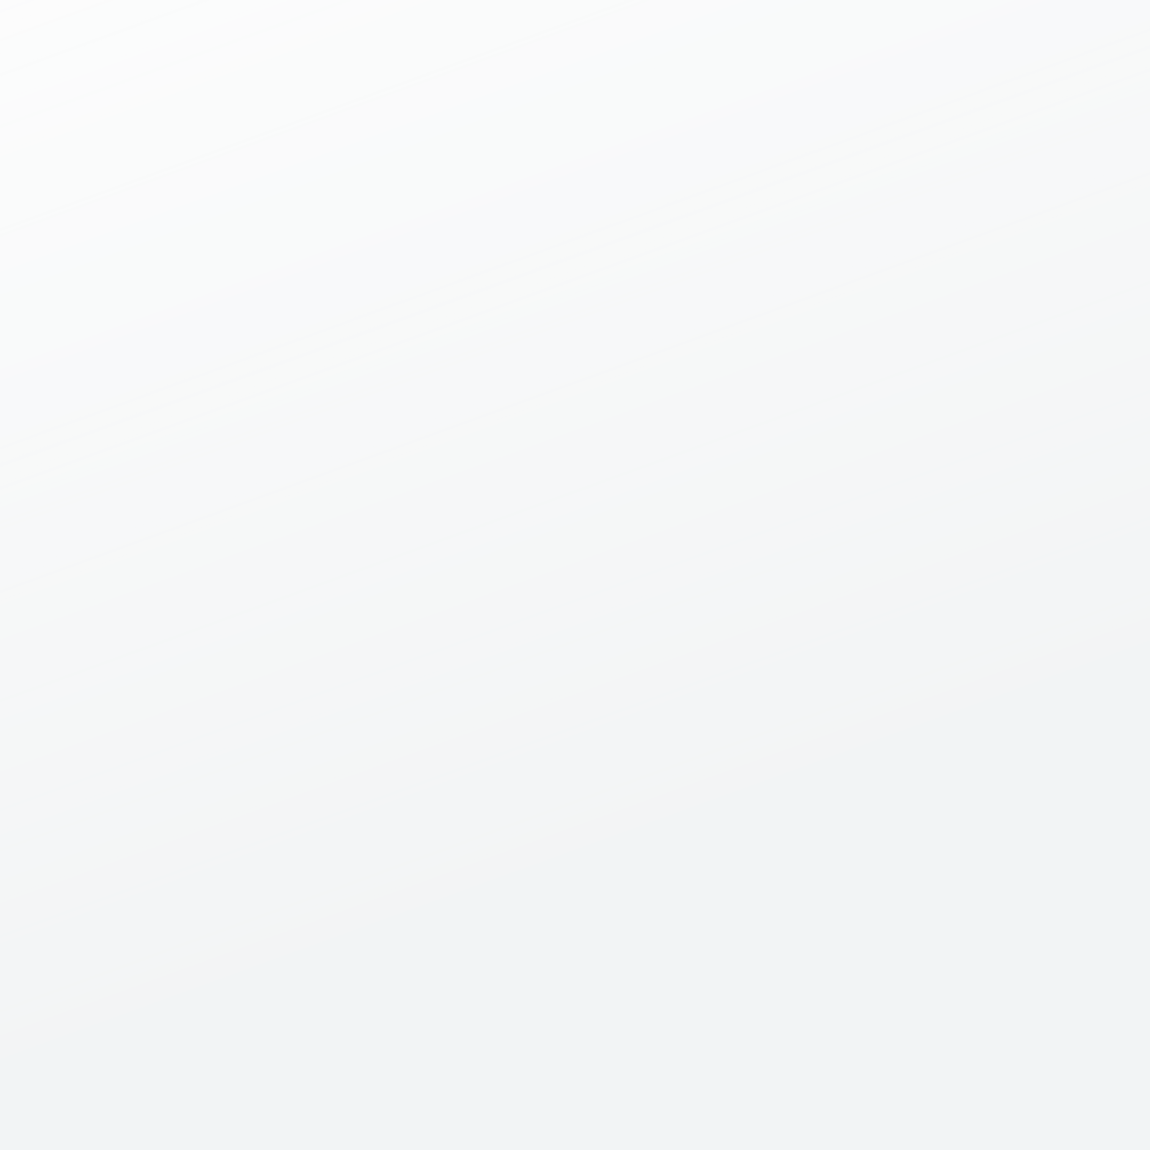
ANIME IMAGE GEN
VAE

Slide 2
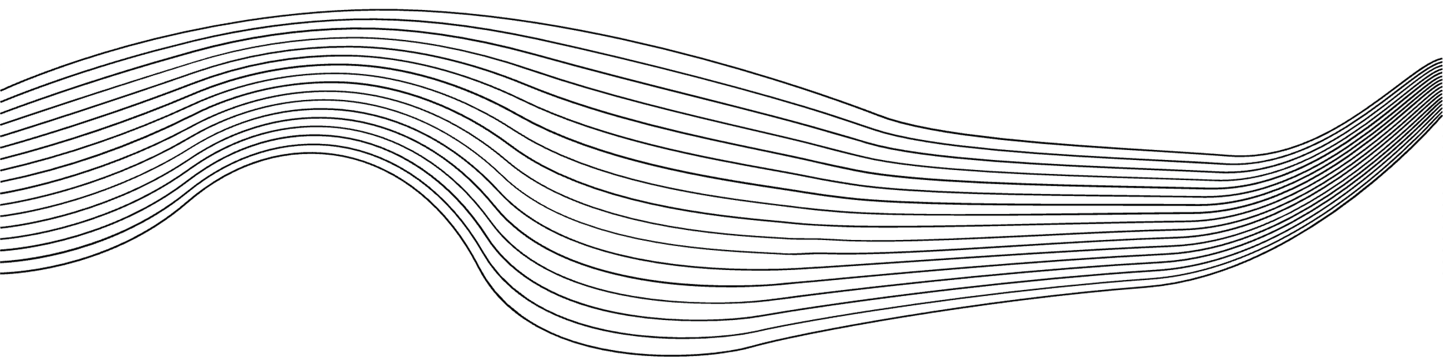
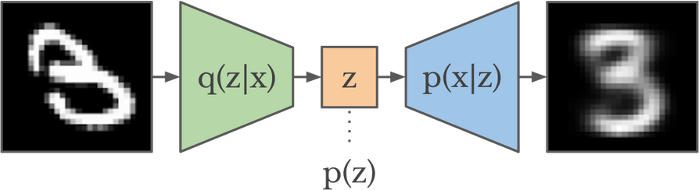
VAE?
THESE MODELS LEARN COMPRESSED REPRESENTATIONS OF DATA (LIKE IMAGES) BY ENCODING THEM INTO A LOWER-DIMENSIONAL LATENT SPACE AND THEN RECONSTRUCTING THEM FROM THAT SPACE
VAE’s for Images: Compression & Randomness = New Images
VAEs take images, compress their key features, and store them in a "latent space."
This space acts like a recipe book of image features.
VAEs can then invent new images by randomly picking features from this recipe book and assembling them.

Slide 3

ARCHITECHTURE
Typically uses convolutional neural networks (CNNs) suited for image data.
CNN layers extract features from the input image, progressively reducing its dimensionality.
The final convolutional layers often output two feature maps:
Mean vector: Represents the central tendency of the latent distribution.
Log variance vector: Captures the spread of the latent distribution.
Uses transposed convolutional layers (sometimes called deconvolutional layers).
These layers take the latent vector as input and gradually increase its dimensionality.
The final transposed convolutional layers aim to reconstruct the original image based on the features encoded in the latent space
ENCODER
This is a lower-dimensional space compared to the original input data.
It contains the compressed representation of the input image, capturing its essential features.
In VAEs, the latent space often follows a standard normal distribution (mean of 0 and variance of 1).
DECODER
LATENT SPACE

Slide 4
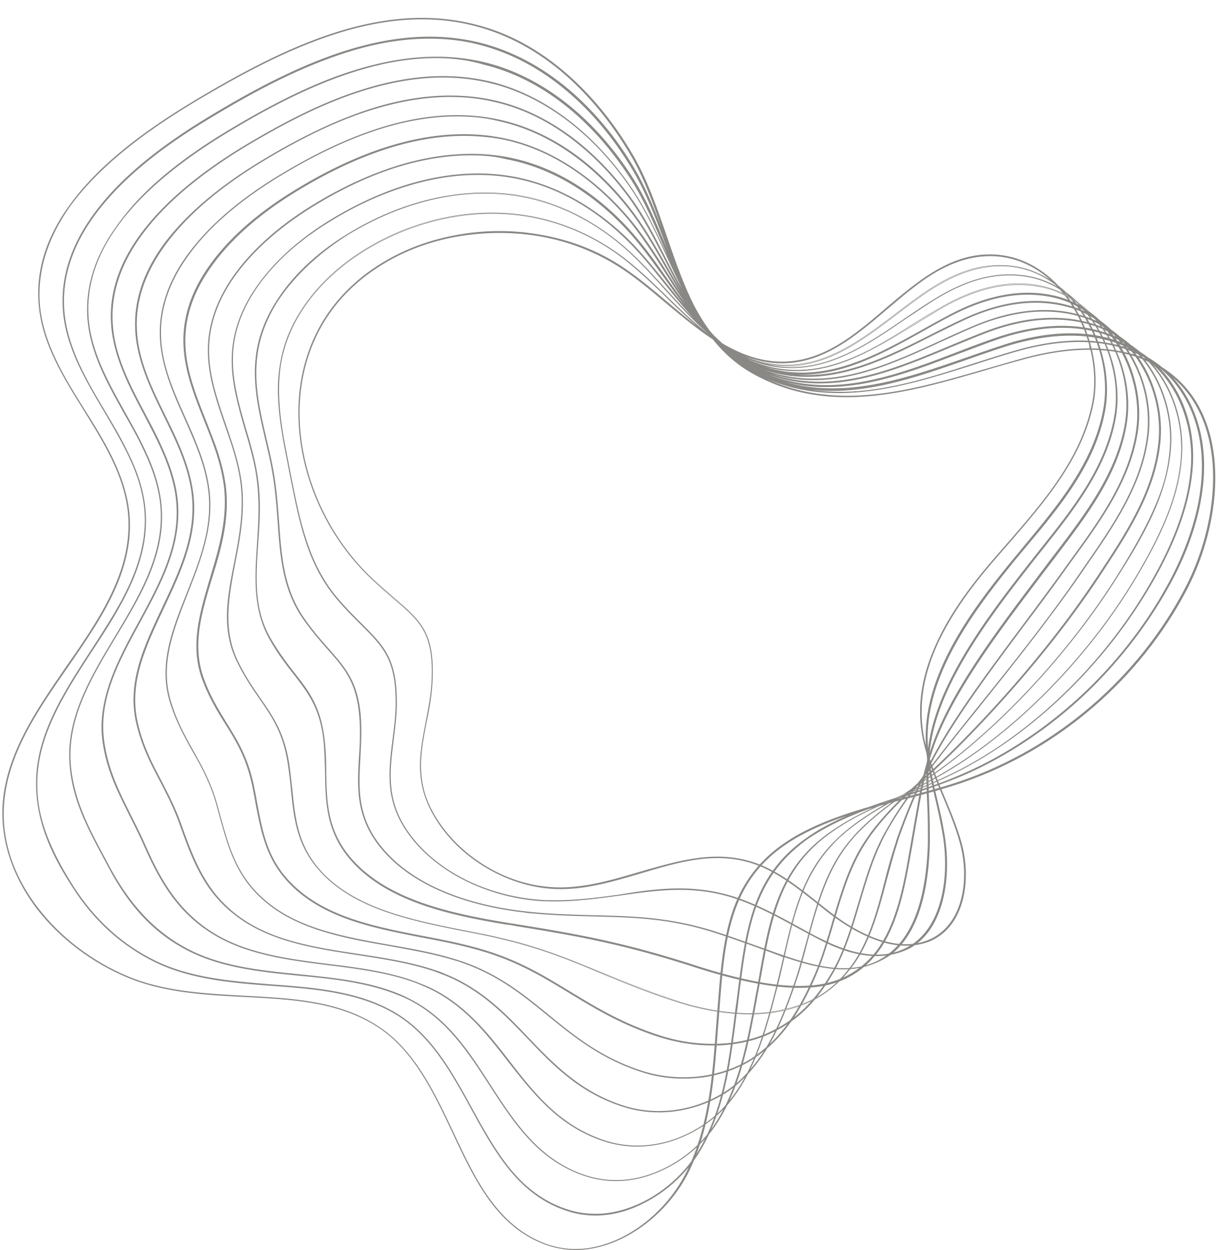
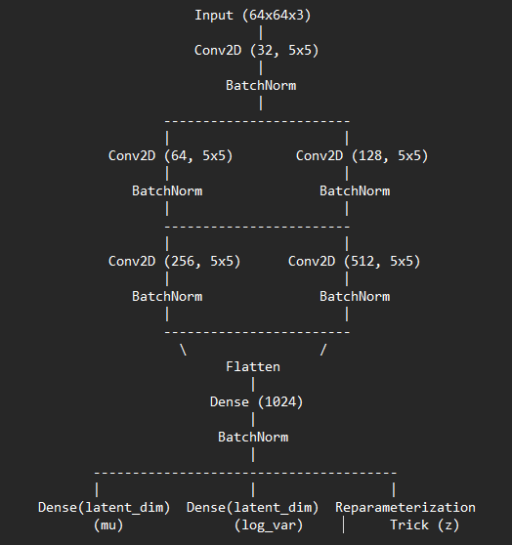

Slide 5
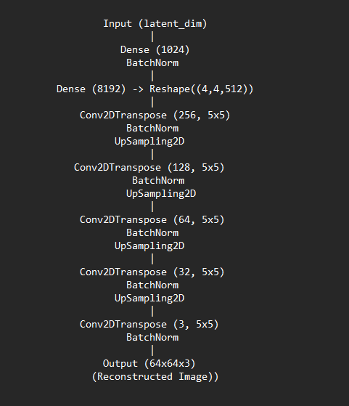

Slide 6
THANK YOU

